Slide 1
IT Procurement Category Strategy (template)
Author, Date

Slide 2
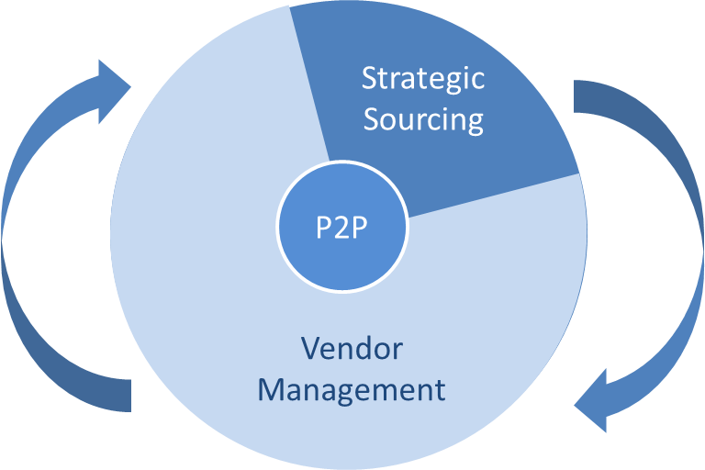
Procurements role
Contract renewal / new requirement
Purchase orders, invoice
management and
compliance with
contract
Tender and negotiate
Contract review and negotiation
Time
Feedback on services and requirements for renewal / re tender
Handover after
contract in place
Category strategy and approach
Time
Regular supplier
performance reviews
Supplier non-performance and
Improvement plans/activities
Process improvements
and operation efficiencies

Slide 3
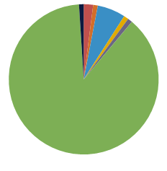
IT Category Overview
Hardware (£)
Software (£)
Telecoms (£)
Services (£)
Consumables, Data, Desktop Hardware, Hosting Services, Peripherals, Storage Hardware
Infrastructure, Applications, Security
Collaboration, Communications, Data Network, Voice, Telecoms
Consultancy, Development and Testing, Hosting, Resellers, Managed services
Insert overview of category spend breakdown by region and supplier
Top IT Supplier Spend
Information Technology
Supplier | Category | 2014 spend | 2015 spend | Contract
 | Total
£m
Annual spend
IT spend by region
IT spend by region
No
suppliers
TBC%
of total spend
The Top 10 IT suppliers account for TBC% of the total IT spend

Slide 4
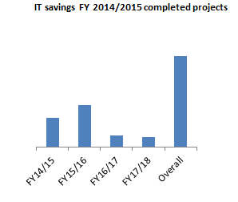
Savings Delivery
FY 2014/2015 Top Projects
Project Name | Savings |  |  |  | Reduction / Avoidance | Description | Status
 | FY2014/2015 | FY2015/2016 | FY2016/2017 | FY2017/2018
FY 2015/2016 Top Projects
Project Name | Savings |  |  |  | Reduction / Avoidance | Description | Status
 | FY2014/2015 | FY2015/2016 | FY2016/2017 | FY2017/2018

Slide 5
IT Category Strategy: Hardware
£k
Annual spend
No
suppliers
Category Overview
Top Hardware supplier spend | Annual spend | Contract expires
Strategic approach
Desktop | PCs and Laptops
 | Printers
 | Peripherals
Data Centre and network | Hosting
 | Server technology
 | Storage technology (Cloud)
Spend by region
Hardware share of IT total spend – TBC%

Slide 6
IT Category Strategy: Software
£k
Annual spend
No
suppliers
Category Overview
Top Hardware supplier spend | Annual spend | Contract expires
Strategic approach
Desktop software | Office Productivity
 | Antivirus
Licence models | Software as a service
Smarter working | Software asset management
 | Cloud
 | Citrix
Mobility | MDM
Spend by region
Software share of IT total spend – TBC%

Slide 7
IT Category Strategy: Telecoms
£k
Annual spend
No
suppliers
Category Overview
Top Hardware supplier spend | Annual spend | Contract expires
Strategic approach
Data | Leverage Market rate reductions effectively
Voice | Tactical renewals
 | IP Telephony
Mobile and Conference | Collaboration
 | Mobile
 | Tablets and Smart devices
Spend by region
Telecoms share of IT total spend – 20%

Slide 8
IT Category Strategy: Services
£k
Annual spend
No
suppliers
Category Overview
Top Hardware supplier spend | Annual spend | Contract expires
Strategic approach
Consultancy | Project Management resource
 | IT Consultancy
Resellers | Rationalisation and improved reporting
Managed services | Data centre hosting
 | IT service desk
 | other
Spend by region
Services share of IT total spend – TBC%

Slide 9
Market Overview
Hardware
Top supplier overview
Focus on more expensive mobile devices and a more frequent update/upgrade is changing the way hardware is purchased
Suppliers moving from hardware models with low % mark up to a focus on supporting
Infrastructure as a service model (HP)
Consumerisation of IT – employees often own and are using more powerful devices
than employers are able/willing to provide and more willing to use these in the work
environment
PC sales are in rapid decline with Tablets and Multi-functional device use increasing
Apple IPad growth is stagnating with cheaper alternatives thriving.
Supplier | Market update
Insert supplier logo
Insert supplier logo
Insert supplier logo
increasing
Software & Services
Suppliers continue to explore new revenue streams outside of traditional products with
a focus on service and managed services
Move towards OPEX models and leasing to avoid costly upgrades
Growing influence and acceptance of Cloud based solutions and Software as a service
Majority of suppliers are moving to cloud based solutions
Telecoms
Very fast pace of change with network capacity increasing year on year driven by a
combination of consumer demand and legislation
Move from traditional voice to VOIP services and resulting impact on increased data
No truly global player in terms of global mobility
Impact of smart devices can be seen in the increasing use of mobile data
Consolidation within the mobile carrier market (BT/EE, O2/Three)
EU legislation continues to drive down EU roaming charges

Slide 10
Top IT Procurement projects pipeline
Project | Status | Forecast spend |  | FY15 |  | FY16 |  |  |  | FY17
 |  |  |  | Q2 | Q3 | Q4 | Q2 | Q3 | Q4 | Q1

