Slide 1
PROCESS

Slide 2

Agile Procurement - Introduction
We are responsible for managing the end to end procurement journey;
Often there are competing imperatives at play when running a tender exercise; be it speed to market, cost or risk and these are usually internally driven
High number of processes and templates we need to manage. These can often be seen as blockers and as ‘slowing down’ the process adding little value
By implementing an agile procurement approach we can help remove this perception and ensure we deliver maximum value at all times.
How much is this going to cost?!?!
We need to get this out the door…now!
This seems very risky to me…

Slide 3
Agile Procurement Methodology
Agile Procurement is a way to streamline sourcing & contracting activities
Key Benefits;
  Focus on more strategic activities which deliver longer term sustainable value
  It ensures processes remain flexible, lean and fit for purpose
  It increases speed to market (time) for projects where this is seen as a high priority
  It enables automation of straight forward tasks / processes
  It ensures a risk based approach to sourcing & contracting.
Agile Procurement Model (APM)
LOW COMPLEXITY
= HIGH AGILITY
Enables a greater degree of automation and streamlining
HIGH COMPLEXITY =
LOW AGILITY
Maintains a high degree of governance and due diligence

Slide 4
Agile Procurement – Tools and Templates
Sourcing requirements are simple; low risk and low value
High level of Agility
applied
Allows for a greater degree of automation, streamlining with less governance
RFI / RFP documents – One Page RFP?
Specification / Requirements
PQQ vs. RFI vs. RFP
Sourcing requirements are complex; high risk and high value and potentially strategic in nature
Low level of
Agility
applied
Allows for a more collaborative, innovative approach to sourcing with a greater emphasis on governance
Supplier Assessment Days
Supplier Evaluation Criteria
Notes:
REDUCE TIME TO MARKET - One Page RFI / RFI
Include example (slide 21)
SPECIFICATION
Are the correct people deciding / writing the specification? (makeup of core (technical skills)
Who is testing those requirements? How do you know if the requirements are correct? Can we share with suppliers to test / validate the specification / requirements (link to the Panel meetings) or can we ask the suppliers to submit what they would typically ask for if they were sourcing the requirement and assess them on this basis?
PQQ / RFI / RFP
Do we need all three stages / templates? (PQQ/ RFI/ RFP?) PQQ to be done electronically / (link to technology)
Do we actually read the information? (portal for regulatory information / policy docs etc)
Are we checking for capability in RFPs or are we making sure the suppliers are compliant? (link to technology?)
SUPPLIER PRESENTATION
Move supplier pitches before RFP stage / ‘open day’ for suppliers
Specification > Supplier Meeting / demons > Response to RFP > Selection
5. SUPPLIER EVALUATION
How do we ensure the criteria used to evaluate suppliers actually has a direct link to the suppliers capability / ability to do the job

Slide 5

Agile Procurement – Supporting the process
Customised Approach…
Specific Needs…
Speed to market…
Complexity…
Different Markets…
Risk…
PROC 4.0

Slide 6
Agile Procurement Model – Determining the process
Procurement process calculator |  |  | Review criteria
To be filled in by the business | Score | Procurement Recommendation | Below columns to be completed by the business
Business need name | Score | Recommendation | Estimated annual spend | Estimated contract term | Criticality level | Information security assessment needed | Global reach (export control) | Material Outsource | SLA needed
New branding kit (pen, notebook, mug and folder) for 5,000 employees | High Agility | Follow the short RFP process | Above £100,000 | One off contract | No impact for loss of service | No | Yes | No | No
New HR platform | Low Agility | Follow the full RFP process | Above £100,000 | More than 3 years | Unable to operate as a firm without this service | Yes | Yes | No | Yes
Notes:
In order to explain how an agile procurement model would work, we developed the methodology to highlight how the process is a dynamic one. Obviously the methodology can be embedded in several technologies, to make the process faster and more
The model shows how a shorter process can be followed – no need to ask perform an IS assessment in all cases; no need to ask for business continuity plans for one off deals; no need to include SLAs in a RFPS document for lanyards. Such methodologies can be used to customize the RFP document and keep in only the relevant information.

Slide 7
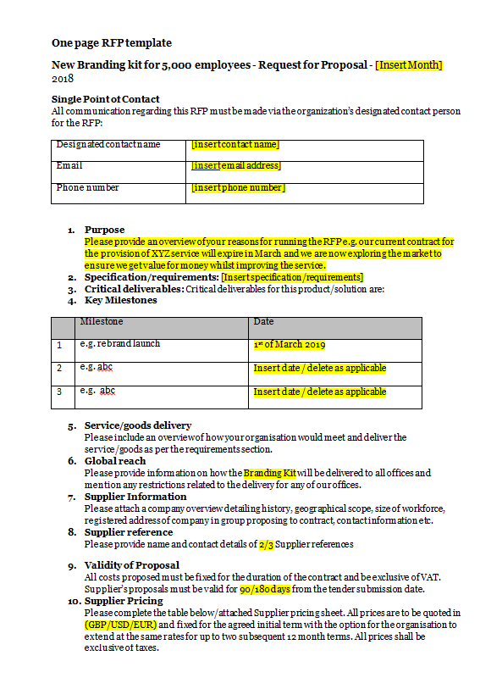
Agile Procurement Model – One Page RFP
Notes:
This is a screen shot from a Word document (a one page document) which shows how by following an agile procurement model, a RFP template can be created; a document focusing on requirements not on compliance (previous stage – PQQ); a document which can be used for low risk items

Slide 8

Contracting
Time consuming negotiation of terms
Important terms
Legal involvement
Alternative wording
Low value / low risk contracts
Education of Stakeholders
Contract cheat sheet
Unsophisticated small suppliers
Education of Suppliers
Contract format
Notes:
We found that contracting was one area that prevents procurement teams from being as agile as we might like. We considered which particular aspects of contracting contribute to pain points for both procurement teams and our stakeholders and suppliers. While there are many pain points in the contracting process we have focussed on three in particular here which are the contract negotiation process, low value / low risk contracts, and unsophisticated small suppliers.
The first point to address is the contract negotiation process. This is one of the more time-consuming areas of procurement contracting. The back and forth with suppliers to agree terms can significantly prevent procurement teams being agile when engaging new suppliers. We identified some ways to improve this process and allow procurement teams to be able to respond more effectively. Firstly, identifying within your contract templates which terms your organisation considers key for inclusion in all contracts, and conversely which terms have less importance and therefore where you can afford more flexibility during the negotiation. Secondly, identifying those terms that require involvement from other departments such as legal, risk or security. This empowers your procurement team to amend other terms and we can therefore avoid involving other departments unless absolutely necessary. A final step could be to identify some pre-approved alternate wording for terms that suppliers frequently request to negotiate. This would require some data analysis of your current contracts and identifying any patterns in approved amendments. This activity would allow you to create a database of pre-approved alternate wording to suggest to suppliers when they push back against those terms. This will also allow your procurement teams to be more agile in negotiating terms and reduce the need to engage further departments.
Next we have low value and low risk contracts. Procurement teams will often spend a significant amount of time contracting with low value-low risk suppliers. You probably already have risk or spend rules for engaging procurement, but how strictly are they enforced? Often a stakeholder will engage us regardless of these risk/spend thresholds and in the interests of maintaining that relationship we don’t push back. However, if you can make your stakeholders more comfortable with the contracting process then there’s less need for them to involve you. Passing the burden of negotiating low value / low risk contracts on to your stakeholders will require educating them about the contracting process, specifically what obligations are in your standard contracts and also which terms will require procurement/legal/risk involvement. In this way the procurement team can become an escalation point but your stakeholders can facilitate the majority of the process. This frees up your time to focus on more strategic projects and higher risk engagements and to be able to respond more agilely in those cases. We can also bring this back to creating a database of alternate wording – if your stakeholders can access that database, this will allow them to work to a solution themselves and only engage procurement when we have value to add.
Finally we have unsophisticated small suppliers. This is a little recognised pain point and barrier to agility. When you have smaller suppliers who may not have their own legal team or be willing to engage external legal counsel before entering into contracts and, further, may not feel empowered to review and negotiate contract terms, you will find that many of these suppliers will sign up to a contract that they may not have fully understood with obligations that they may not actually be able to meet. While initially this means that the contract negotiation process is quite straightforward from our end, it also means that you’re more likely to encounter problems further down the track. Spending the extra time at the start to ensure that your suppliers are educated about their obligations and making sure they understand that you’re open to negotiation means you identify any potential contractual issues now when you have the chance to resolve them. One way of doing this is similar to my previous point around educating stakeholders which is to provide a cheat sheet and we’ll show you an example shortly. This cheat sheet is a way to identify the obligations of each party in a simple way. This doesn’t need to replace your current contracts (and I’m sure legal wouldn’t approve that anyway!) but is intended to be an additional information sheet so that these smaller suppliers can quite clearly understand what they’re signing up for.

Slide 9
















19.1 All information supplied to you by us is confidential. You may not use our name or brand in advertising or otherwise.
10.1 Any premises provided by us may only be used for providing the services under this contract
11.1 You warrant that you are fully experienced, qualified, equipped, organised and financed to perform your obligations under the contract and that:
any goods will be of satisfactory quality and fit for their purpose; and will comply with all statutory and similar requirements; or
any services will be performed by appropriately qualified and trained personnel, with due care and diligence and to such high standards of quality as it is reasonable for us to expect in all circumstances; and will comply with all statutory and similar requirements.
20.2 You must not engage in acts of bribery or corruption contrary to law. You must have appropriate policies and processes in place to ensure no bribery or corruption occurs. You must notify us if you become aware of bribery or corruption by your staff.
Your Rights and Obligations
17.1 You must not be placed in a position where there is a conflict between your duties under this contract and your financial or personal interests.
C
O
18.1 Where you process personal data, you must comply with applicable legislation and our instructions.
13.1 You must always hold insurance against your liability under this contract.
N
T
9.1 You are responsible for damage of any goods until they are delivered to us.
18.2 You must protect against unauthorised or unlawful processing, and against accidental loss or destruction, of our data.
T
R
A
C
E
H
C
H
A
S
E
E
T
T
12.2 If goods/services are not in line with the contract, then we can require you to repair or replace them.
15.1 We can terminate the contract immediately if:
You breach the contract and do not remedy it within 14 days
Your organisation is wound up
You attempt to assign your rights or obligations under this contract
14.1 Neither party is liable for breach of this contract due to activities beyond their reasonable control
Mutual Rights and Obligations
Our Rights and Obligations
21.1 Any waivers of rights under this contract must be in writing and only apply to the other party and under the circumstances given.
21.4 No third parties have rights under this contract.
16.1 Pre-existing IP belongs to the pre-existing owner.
6.1 We will pay invoices within 30 days
16.3 IP created in connection with this contract belongs to us.
21.2 This contract does not create a partnership between the parties nor provide authorisation for either party to act on behalf of the other party.
Notes:
So, here is the ‘cheat sheet’ that we have created as an example. As you can see, it quite clearly identifies what the ‘supplier’ obligations are, what ‘our’ obligations are as the customer and any ‘mutual’ obligations. Each of the terms are rewritten using straight-forward language and deliberately avoiding legalese. I’ve also added clause references so that suppliers can cross-reference if, for example, there’s an obligation they know they can’t meet, they can identify where that term lies in the contract for later negotiation.

