Slide 1
TECHNOLOGY

Slide 2


End-to-End Solution
erp
b2b
p2p
srm
crm
auction
requisition
contract
mgmt
spend analytics
requirement
rfx
risk
mgmt
supplier
portal
performance
mgmt
purchase order
customer insight

Slide 3


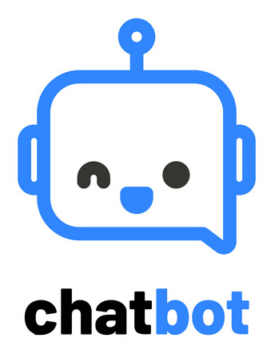













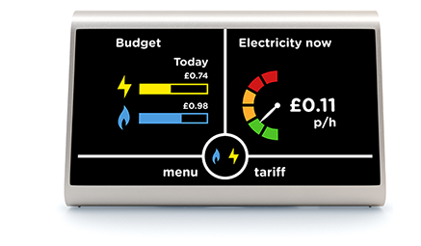


The 4.0 Market Offering
High
VALUE
AGILE 4.0
Low
High
COST

Slide 4


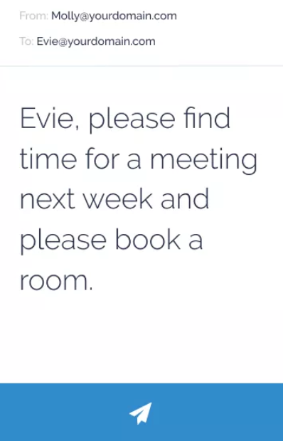
Automated Assistant
Evie is an AI scheduling assistant that optimises
Resources with automation.
Cc Evie on your email - she will use AI technology
to confirm next Steps and organise any meetings
AGILE 4.0
USES:
Manage your meeting rooms and resources
Automate your meeting scheduling and calendar management
Identify actions and add to working list

Slide 5
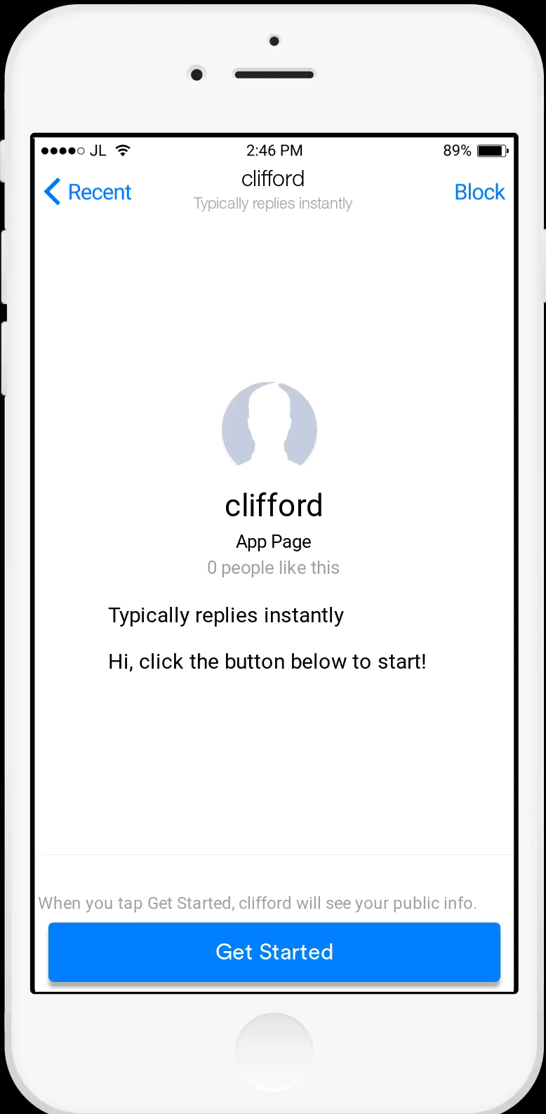
ChatBot
EFFICIENCY
TIME
Productivity
Driving innovation to
increase productivity

Slide 6
More than just Procurement Queries…
As part of a company Intranet, the bot can be
programmed to answer a varied type of queries.
Which means closer integration for Procurement!
What’s Gile’s
Phone Number?
Can you provide me with
a spend report for Microsoft?
Which meeting rooms are
Free?
How much did my
department
Spend in 2017?
I want to submit
an Expense
How do I raise an invoice?

Slide 7

DEMO
https://clifford-chance.glitch.me

Slide 8

The possibilities are endless
Notes:
Anything that is repeatable or can be defined by rules can in essence be
Automated and/or Digitised.
The driver is innovation and the ability to rapidly respond to everything from
internal scope to market conditions.
‘Creating value propositions’ is Procurement’s new modus operandi.

Slide 9

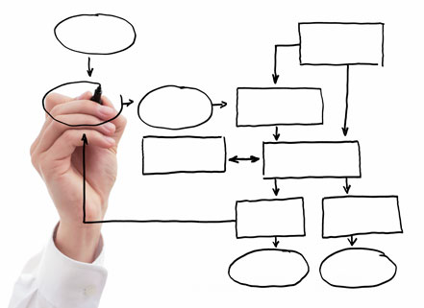

Wrap up
People
Process
Technology
Notes:
Taking into account the original statement,
Procurement /Sourcing teams processes have not materially evolved over time, and are seen as a cost burden/ time delay that gets in the way of agile business- do the group think this is True or False.
We believe that currently this is true
Through our agenda we have discussed how we support procurement activities to stop this being the case, through:
People: looking at Skills and Attributes, and the procurement journey, including blockers and adding value, with the introduction of Giles, our procurement professional of the future
Process: we looked at agile procurement, what it is, suitable methodologies and finally some tools and templates to support procurement activities, such as the one page RFP and the procurement calculator
Technology: we explored the end-to-end process, and the touch points from a technology perspective. We reviewed the market offering for 4.0, and some of the tools we have researched.
We focused on 2 solutions, the meeting room booking system and the chat-bot, with a live demo of how it can be used for both procurement and wider teams/audiences.

