Slide 2
















CIPS Professional Services Procurement
4.0 - Participants
Alexandra Barbus
Procurement Operations Team Leader
Jack Greenwood
Procurement Manager
Rhiannon Willis
IT Vendor Manager
Aman Somal
IT Procurement Manager
Alicia Caley
IT Strategic Sourcing Specialist
Rebecca Thomas
HR Contracts & Sourcing Advisor
Laura Davidson
IT Supplier Relationship Manager
Rupa Bhatt
Category Manager
Laura Gardiner
Global Procurement Specialist
Notes:
Introduce the Proc 4.0 group, mention company representation

Slide 3
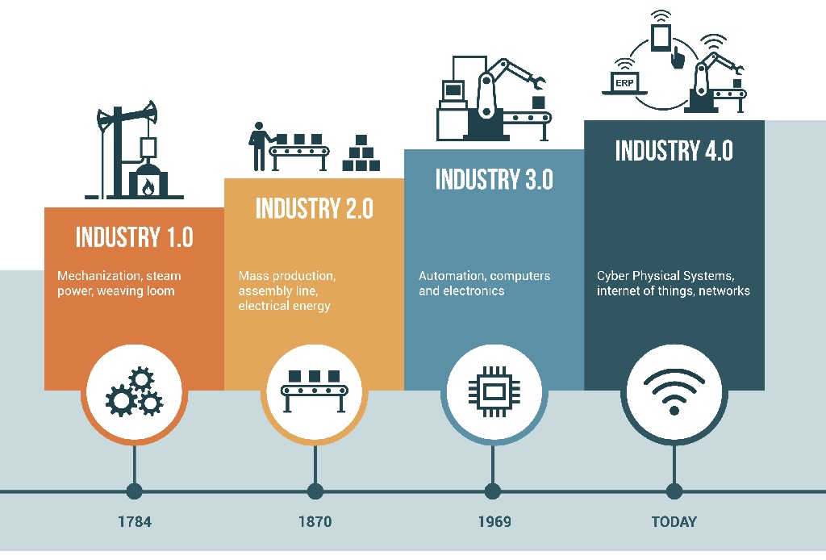
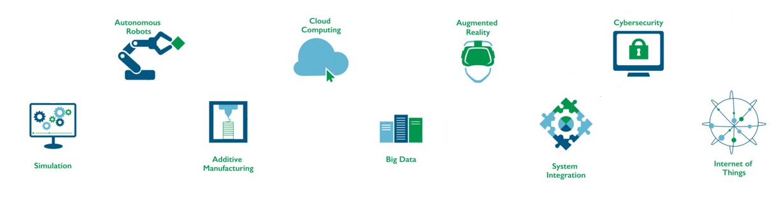
Industry 4.0
Notes:
Looking at the diagram, moving through the evolution to industry 4.0 is as follows:
1.0 – steam powered, manual
2.0 – start to look at efficiencies, such as mass production, assembly line
3.0 – introduction of automation and computers to support the process
4.0 – technology is at the forefront of what we do
To put this into context, think of a car:
1.0 – it isn’t even a car, it is a horse drawn carriage
2.0 – the first steam powered car introduced, with battery
3.0 – start to think about a bit more than just the car moving, safety features, with seat belts being introduced
4.0 -

Slide 4
“With the emergence of industry 4.0,
How can we make procurement more
Agile?”
Notes:
We were asked the following problem statement:
Procurement /Sourcing teams processes have not materially evolved over time, and are seen as a cost burden/ time delay that gets in the way of agile business- do the group think this is True or False and please explain the response.
Action: Propose how Procurement / Sourcing teams of the future can be more agile, whilst still providing its core value proposition of obtaining the best commercial deal with the right supplier.
Areas to consider:
RFP; Contracting; Onboarding; Technology; Other

Slide 5

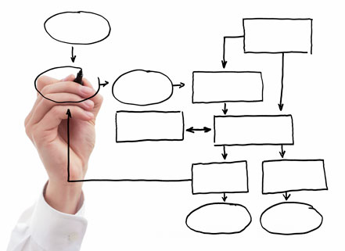

People
Process
Technology
Notes:
Taking into account the problem statement, we are going to talk through the following agenda:
People: looking at Skills and Attributes, and the procurement journey, including blockers and adding value.
Process: we will be looking at agile procurement, what it is, suitable methodologies and finally some tools and templates to support procurement activities.
Technology: we will be exploring the end-to-end process, and the touch points from a technology perspective. We will explore the market offering for 4.0, and some of the tools we have researched.
We will then focus on 2 solutions, and there may even be a demo, who knows!

Slide 6
















19.1 All information supplied to you by us is confidential. You may not use our name or brand in advertising or otherwise.
10.1 Any premises provided by us may only be used for providing the services under this contract
11.1 You warrant that you are fully experienced, qualified, equipped, organised and financed to perform your obligations under the contract and that:
any goods will be of satisfactory quality and fit for their purpose; and will comply with all statutory and similar requirements; or
any services will be performed by appropriately qualified and trained personnel, with due care and diligence and to such high standards of quality as it is reasonable for us to expect in all circumstances; and will comply with all statutory and similar requirements.
20.2 You must not engage in acts of bribery or corruption contrary to law. You must have appropriate policies and processes in place to ensure no bribery or corruption occurs. You must notify us if you become aware of bribery or corruption by your staff.
Your Rights and Obligations
17.1 You must not be placed in a position where there is a conflict between your duties under this contract and your financial or personal interests.
C
O
18.1 Where you process personal data, you must comply with applicable legislation and our instructions.
13.1 You must always hold insurance against your liability under this contract.
N
T
9.1 You are responsible for damage of any goods until they are delivered to us.
18.2 You must protect against unauthorised or unlawful processing, and against accidental loss or destruction, of our data.
T
R
A
C
E
H
C
H
A
S
E
E
T
T
12.2 If goods/services are not in line with the contract, then we can require you to repair or replace them.
15.1 We can terminate the contract immediately if:
You breach the contract and do not remedy it within 14 days
Your organisation is wound up
You attempt to assign your rights or obligations under this contract
14.1 Neither party is liable for breach of this contract due to activities beyond their reasonable control
Mutual Rights and Obligations
Our Rights and Obligations
21.1 Any waivers of rights under this contract must be in writing and only apply to the other party and under the circumstances given.
21.4 No third parties have rights under this contract.
16.1 Pre-existing IP belongs to the pre-existing owner.
6.1 We will pay invoices within 30 days
16.3 IP created in connection with this contract belongs to us.
21.2 This contract does not create a partnership between the parties nor provide authorisation for either party to act on behalf of the other party.
Notes:
So, here is the ‘cheat sheet’ that we have created as an example. As you can see, it quite clearly identifies what the ‘supplier’ obligations are, what ‘our’ obligations are as the customer and any ‘mutual’ obligations. Each of the terms are rewritten using straight-forward language and deliberately avoiding legalese. I’ve also added clause references so that suppliers can cross-reference if, for example, there’s an obligation they know they can’t meet, they can identify where that term lies in the contract for later negotiation.

