Slide 1


Take part
Be heard
Shape the future
Notes:
Hello, welcome etc.
Today I would like us to have a conversation. Not just any conversation.
In 2026, under the leadership of Ben Farrell, chief executive of the Chartered Institute of Procurement & Supply (CIPS), we are launching The Great Conversation.
Our aim is to understand better the forces reshaping our world. And, specifically, to explore what they mean for the procurement and supply chain profession.
We want this to be a truly global conversation.
We’ve made a short movie to tell you more ….

Slide 2

Notes:
The Great Conversation Movie – play video

Slide 3
What is
The Great Conversation?
It is a worldwide dialogue about the future of our profession – and the capabilities we will need in a world defined by rapid change, new technologies, shifting demographics, geopolitical pressure and rising environmental risk.
Notes:
We want to involve people currently working in procurement and supply chain roles; people thinking of working in the profession; people with an interest in the profession; and even those who do not know much about the profession but who could be drawn into it.
We are holding The Great Conversation because, we believe, procurement and supply chain professionals could play a pivotal role in our fast-changing world.
What is The Great Conversation? – well, it’s a worldwide dialogue about the future of our profession – and the capabilities we will need in a world defined by rapid change, new technologies, shifting demographics, geopolitical pressure and rising environmental risk.

Slide 4
And why now?
The world is going through a period of extraordinary demographic, technological and political change. The speed of change shows no sign of reducing and raises many hard, often troubling questions.
Notes:
We live at a time of extraordinary, exciting, unsettling change.
Our world, our organisations, our daily lives are being reshaped by powerful forces forces such as population and demographic change; rapid technological advances; geopolitical volatility; the changing nature of business itself.
Let's hear from Ben himself about why now is the right time to have The Great Conversation…..
[move to next slide and play video]

Slide 5
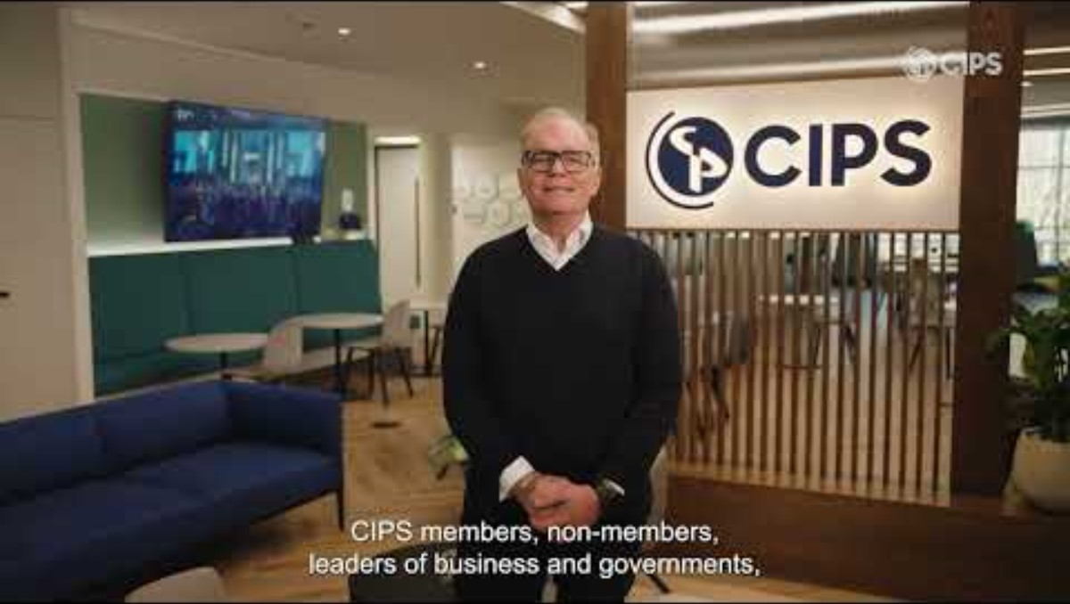
Notes:
Ben’s video - play

Slide 6
What do you think the procurement & supply profession will look like in 2050?
Notes:
As I explained at the beginning, this is very much a listening exercise. We want to hear what the global procurement and supply chain community has to say.
So how do you best think about the future? It can be difficult. The present is so all-consuming that thinking about the world in five, ten, 15, or 20 years can be challenging.
Don't worry, we've got this covered …. We asked the brilliant futurist Dr Graham Norris to help us think about the future. Graham has a deep interest in the procurement and supply chain profession, here's his advice on freeing up your mind to think about the bigger, longer-term questions...
[move to next slide and play video]
And to help you think like a Futurist, here's a short video from Organisational Psychologist and Futurist, Dr Graham Norris.....

Slide 7
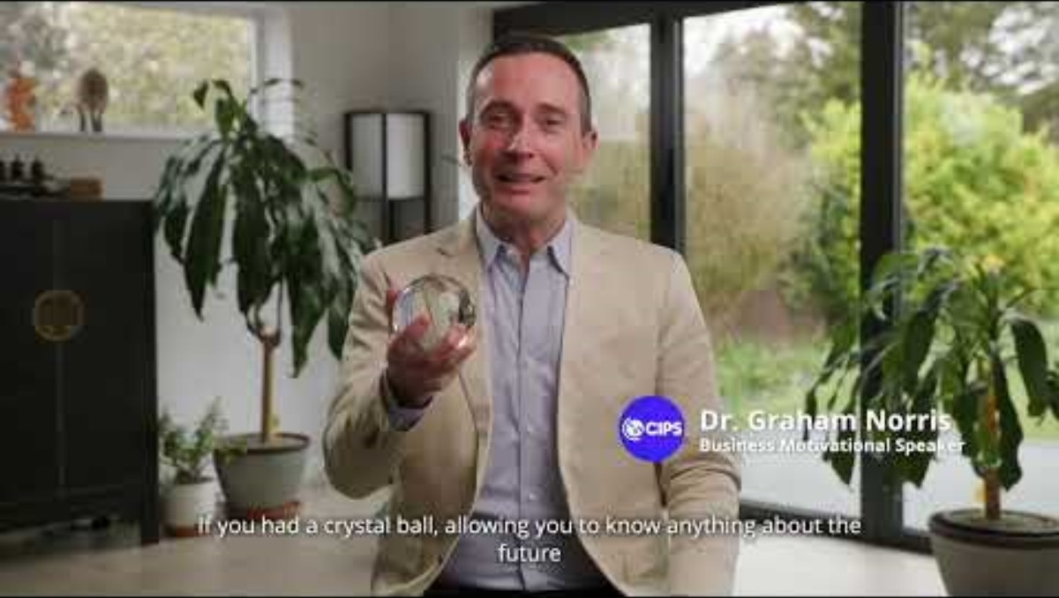
Notes:
Dr Graham Norris video – play video

Slide 8

to The Great Conversation at today's event
How to join The Great Conversation?
Contribute
or you can do it later via our socials #TheGreatConversation
The Great Conversation Hub on
cips.org/the-great- conversation
or email us at: thegreatconversation@cips.org
Notes:
So, a final few details.
We want you – and your network – to take part in The Great Conversation.
We want to know how you see the future for this great profession. What will it look like in 2050?
There are lots of ways to get involved, both individually and by taking The Great Conversation to your own communities and getting them involved in the dialogue.
Let's have a great conversation!

Slide 9

Expected outputs
Notes:
Optional slide if needed
We are going to work hard to mobilise as much of the profession as possible to get involved in The Great Conversation.
And then we are going to work hard to analyse all the information we have captured and share back with our global community the outputs of the dialogue.

Slide 10
And what will the key outputs be?
The Great Conversation Insights Report
A C-suite Report – Why your procurement and supply chain professionals are critical to your organisation's future
A Manifesto for Young People & Career-changers – Why procurement and supply chain management is a dynamic future career
Podcast series
CIPS advocacy for the procurement and supply profession
Notes:
Optional slide if needed
In terms of outputs from our Great Conversation, then specifically, we are planning to produce:
The Great Conversation Insights Report
C-suite Report – Why your procurement and supply chain professionals are critical to your organisation's future
A Manifesto for Young People & Career-changers – Why procurement and supply chain management is a dynamic future career
Podcast series
CIPS advocacy for the procurement and supply profession

Slide 11
Take part
Be heard
Shape the future
Notes:
Thank you.

Slide 12
If you need any support with The Great Conversation, please contact:
thegreatconversation@cips.org

